Slide 1
AVL
Trees

Slide 2
AVL TREES
An AVL tree is a Binary Search tree in which the
heights of the subtrees differ by no more than one and
every subtree is an AVL tree.
An AVL tree is a Height-balanced binary search tree.
The balance factor for any node in an AVL tree must be +1, 0, or -1.
The descriptive identifiers, LH for left high(+1) to
indicate that the left subtree is higher than the right
subtree, EH for even high(0) to indicate that the
subtrees are the same height, and RH for right high(-1)
to indicate that the left subtree is shorter than the right
subtree.

Slide 3
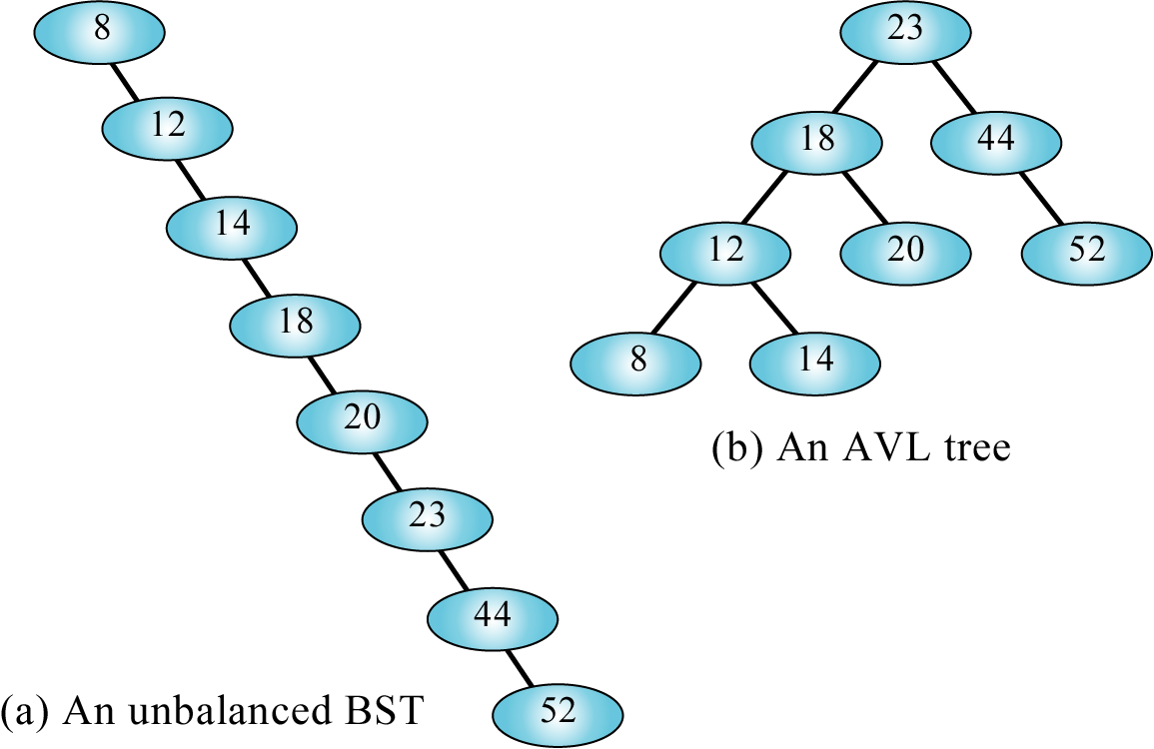
Figure 8-12

Slide 4
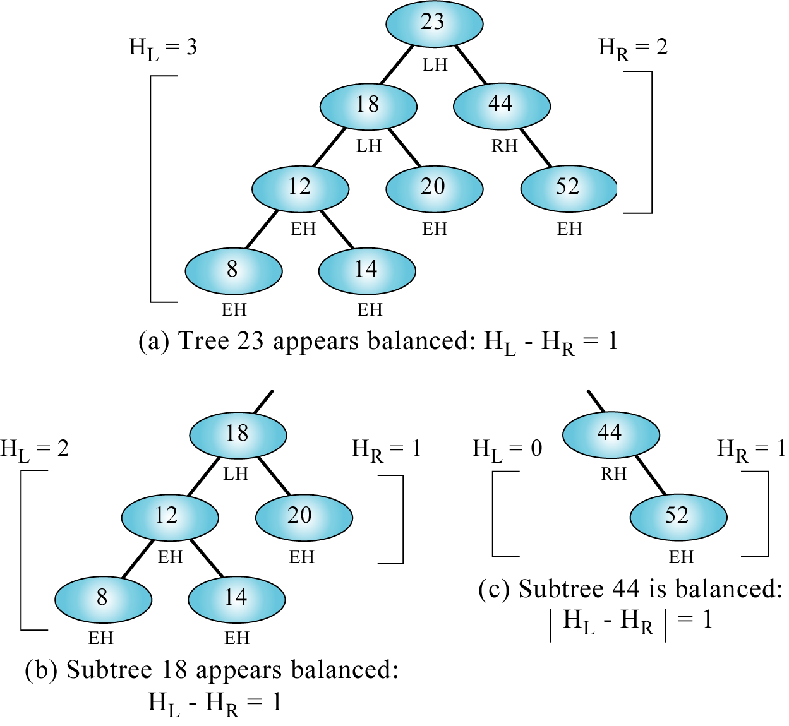
Figure 8-13

Slide 5
Balancing AVL trees
Balancing AVL trees is done by rotating nodes
either to the left or to the right.
All unbalanced trees fall into one of these four
cases.
Left of left(Rotate Right)
Right of right(Rotate Left)
Right of left
Left of right

Slide 6
LEFT OF LEFT(Rotate Right)
When the out of balance condition has been
created by a left-high subtree of a left-high
tree,we must balance the tree by rotating the
out-of-balance node to the right.

Slide 7
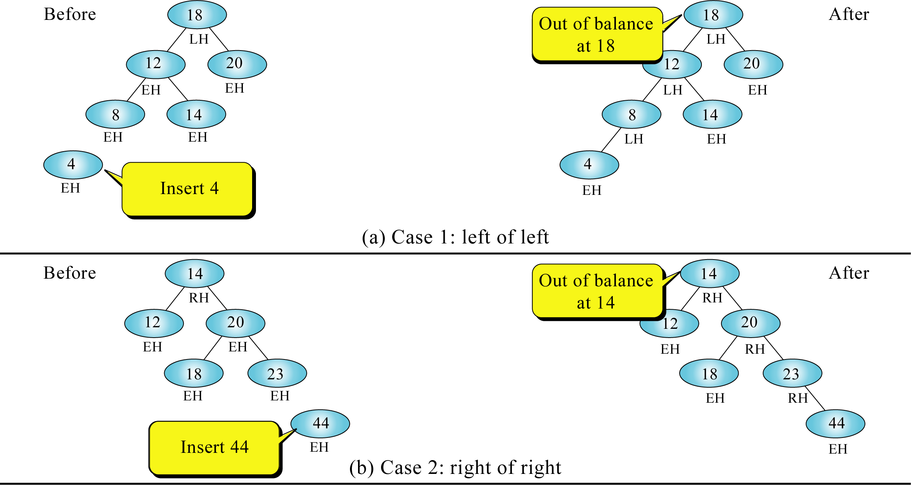
Figure 8-14 (a and b)

Slide 8
RIGHT OF RIGHT(Rotate Left)
When the out of balance condition has been
created by a right-high subtree of a right-high
tree,we must balance the tree by rotating the
out-of-balance node to the left.

Slide 9
RIGHT OF LEFT
The first two cases required single rotations to
balance the trees. In this case we need to rotate
two nodes, one to the left and one to the right, to
balance the tree.
In this case we see an out-of-balance tree in
which the root is left high and the left subtree is
right high. To balance this tree, we first rotate
the left subtree to the left, then we rotate the root
to the right making the left node the new root.

Slide 10
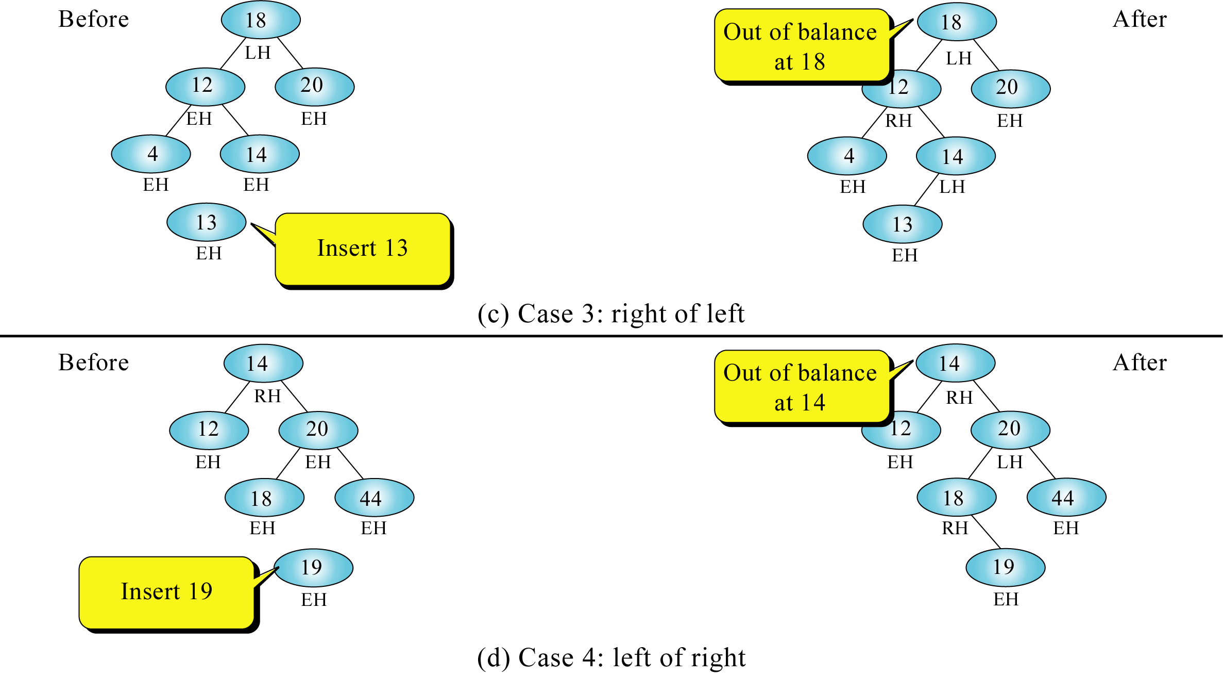
Figure 8-14 (c and d)

Slide 11
LEFT OF RIGHT
To balance the tree, we first rotate the right subtree and then rotate the root left.
Because the out-of-balance condition is
created by a left-high subtree on a right-high
Branch, we must double rotate . We begin by
rotating the right subtree to the right, we then
rotate the root left, which gives us the balanced
tree.

Slide 12
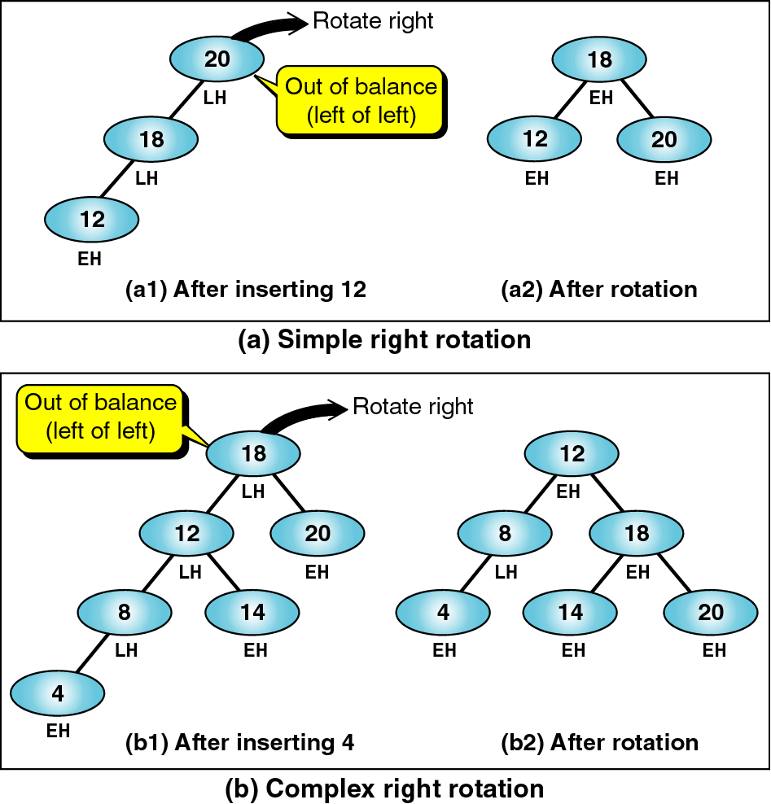
Figure 8-15

Slide 13
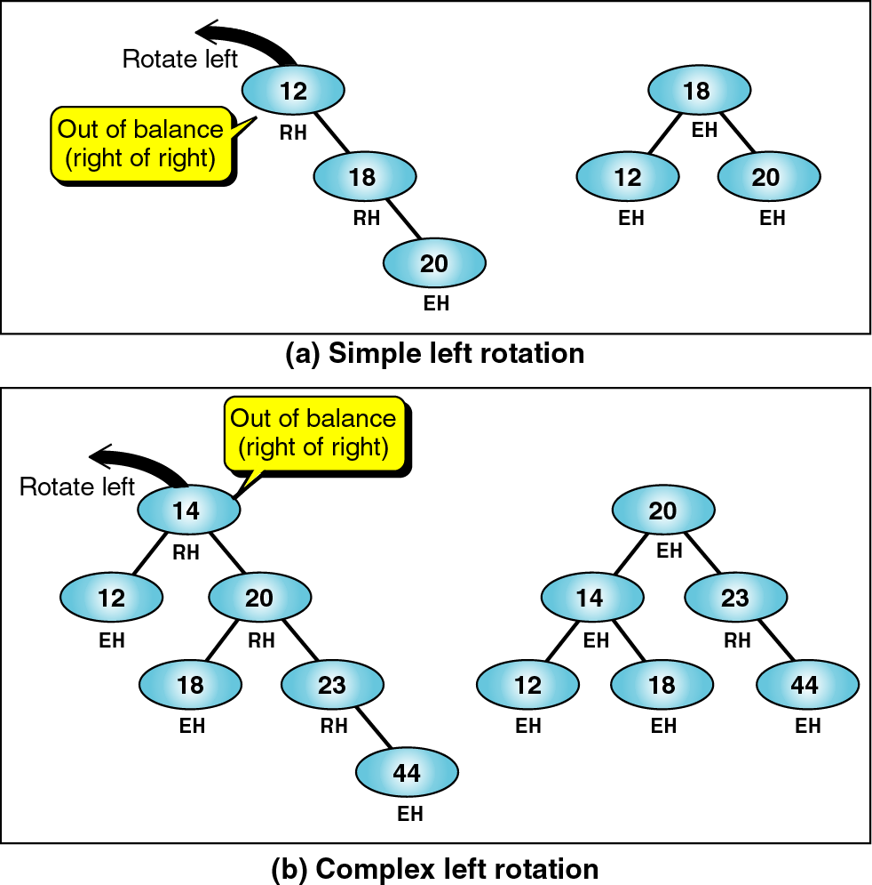
Figure 8-16

Slide 14
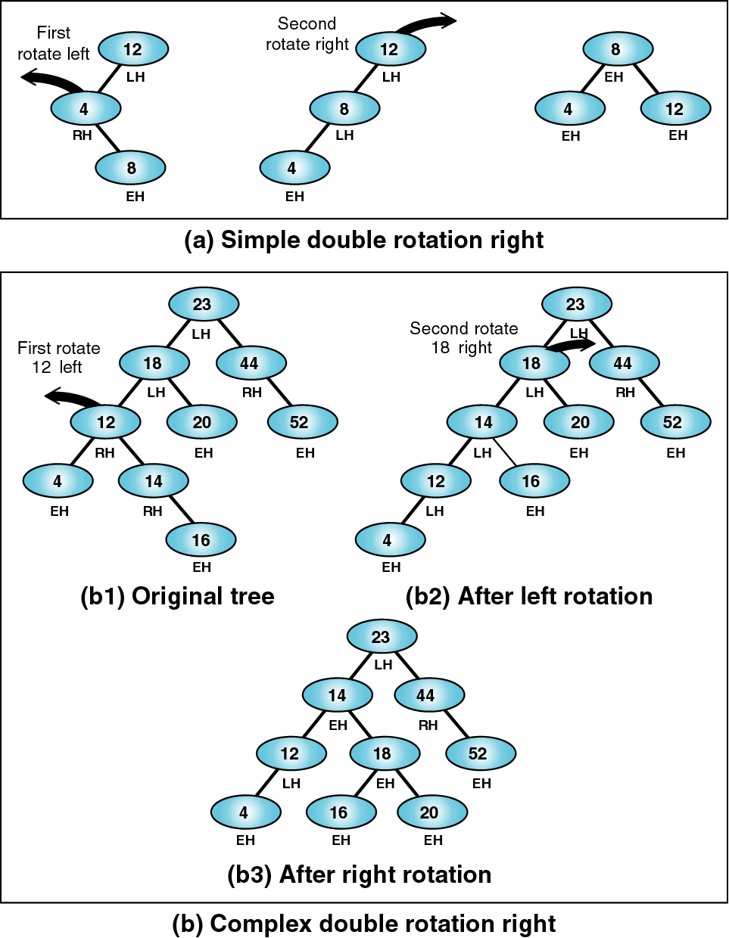
Figure 8-17

Slide 15
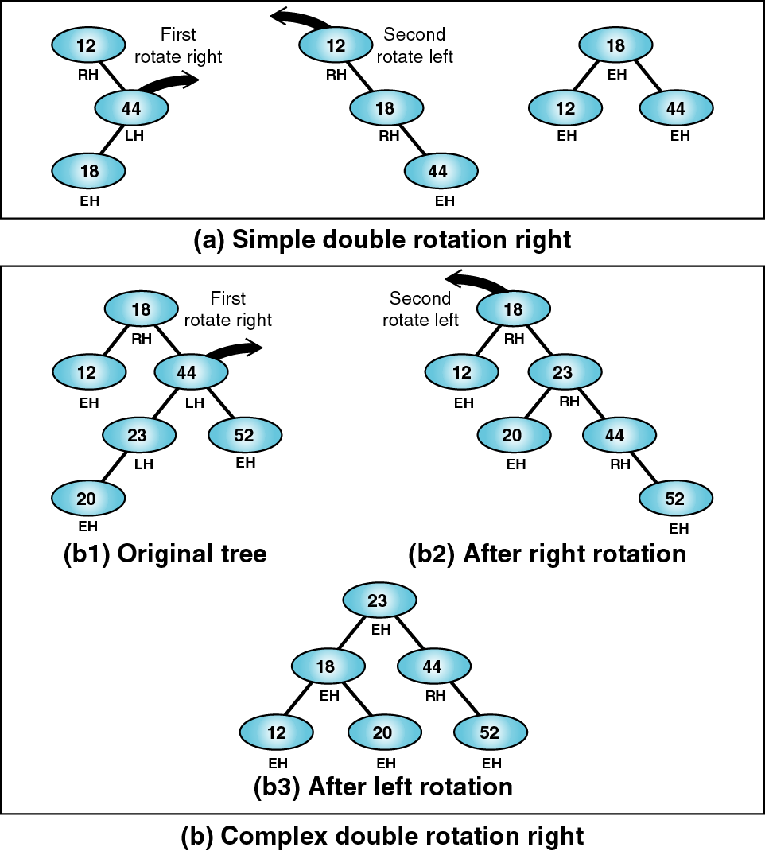
Figure 8-18

Slide 16
AVL Tree Node structure
struct node
{
int key;
int data;
struct node *left;
struct node *right;
int bal ;
}NODE;

Slide 17
typedef struct
{
int count;
NODE * root;
} AVL_ TREE;
Algorithm AVL_Create(tree)
{
AVL_TREE * tree
tree = (AVL_TREE * ) malloc (sizeof (AVL_TREE));
if (tree)
{
tree → root = NULL;
tree → count = 0;
}
}

Slide 18
Inserting a node into a AVL tree
Algorithm AVLinsert(NODE *root, NODE
*newptr, int *taller)
1) // Insert at root
if (root != null)
{
*taller = true;
root = newptr;
return root
}
2) if (newptr → key < root → key)
insert(root → left, newptr, taller)

Slide 19
if (taller)
if (root left-high)
leftBalance (root, taller)
Adjust balance factor
else
if (root right-high)
taller = false
Adjust balance factors
else
3) if (newptr → key > root → key)
insert(root → right, newptr, taller)
if (taller)
if (root left-high)
taller = false

Slide 20
else
if (root right-high)
rightBalance(root, taller)
Adjust balance factors
else
error (“ duplicate data “)
recycle(newptr)
taller = false
return
}// end of AVLinsert

Slide 21
Algorithm leftBalance( root *node, taller boolean)
// This algorithm is implemented when the root is left
heavy ( i.e the left subtree is higher than the right
subtree).
leftTree = root → left;
if (leftTree left-high)
// Case 1 : Left of left . Single rotation required.
rotateRight(root)
Adjust balance factors
taller = false
else
// Case 2 : Right of left . Double rotation required.
rightTree = leftTree → right;
Adjust balance factors
rotateLeft (leftTree)
rotateRight (root)

Slide 22
taller = false
return
}// end of left balance
Algorithm rotateRight(root *node)
// This algorithm exchanges pointers to rotate the tree
right.
tempPtr = root → left;
root → left = tempPtr → right;
tempPtr → right = root;
root = tempPtr;
return
} // end of rotateRight

Slide 23
Algorithm rotateLeft(root *node)
// This algorithm exchanges pointers to rotate the
tree left.
tempPtr = root → right;
root → right = tempPtr → left;
tempPtr → left = root;
root = tempPtr;
return
} // End of rotate left

Slide 24
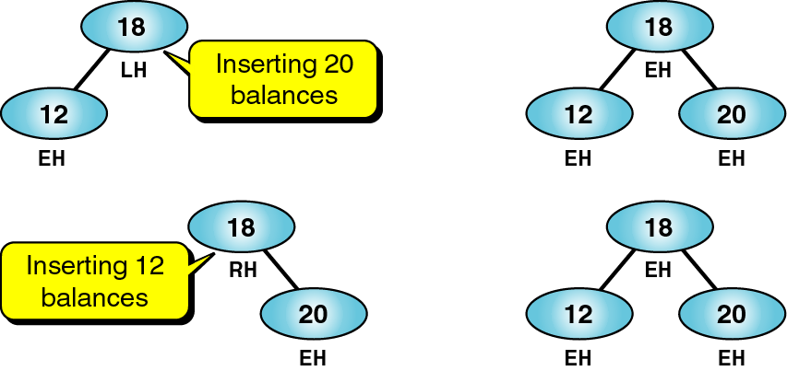
Figure 8-19

Slide 25
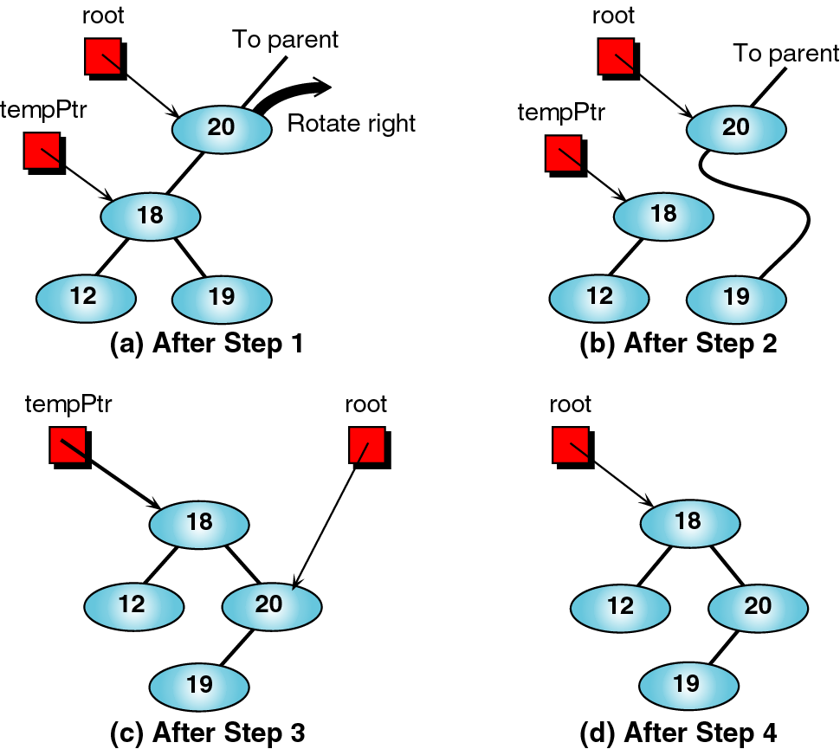
Figure 8-21

Slide 26
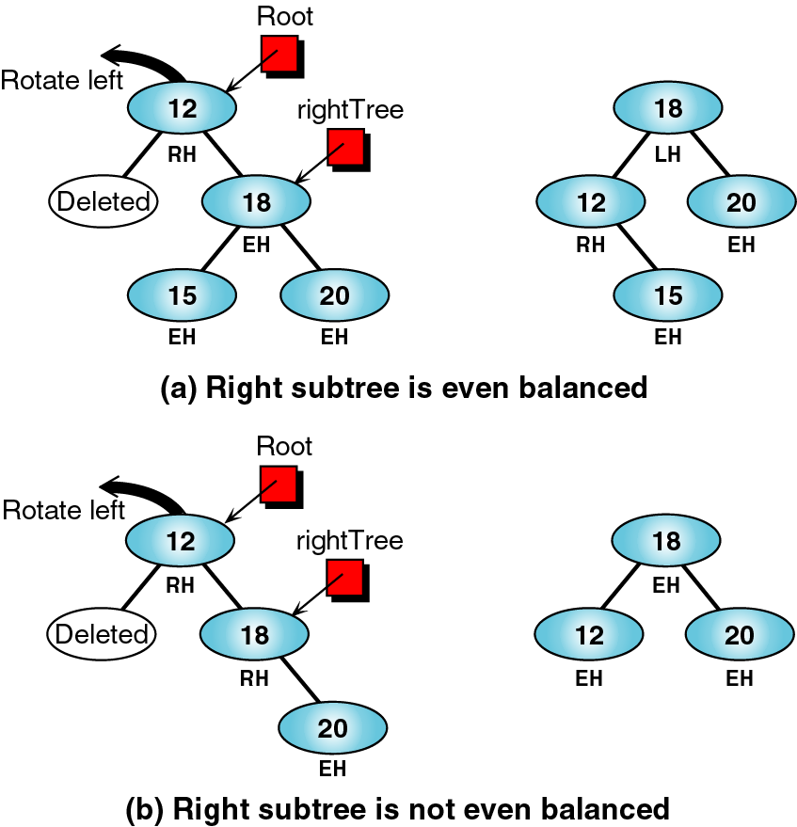
Figure 8-22

Slide 27
Deleting a node from a AVL list
To delete a node from an AVL list, we need to determine if it is a leaf or leaflike node.
If a node has two subtrees, we must search for a Left subtree
for its largest node. When we find it, we move its data to
replace the deleted data and then recursively call the delete
function to delete a valid leaf node.
We must search for a Right subtree for its smallest node.
When we find it, we move its data to replace the deleted data
and then recursively call the delete function to delete a valid
leaf node.

Slide 28
Delete Right balance is used when a delete has
occurred on a left subtree and the tree needs to be
rebalanced. We need to rebalance only if the root is
right high.
Delete Left balance is used when a delete has
occurred on a right subtree and the tree needs to be
rebalanced. We need to rebalance only if the root is
left high.
Because the out-of-balance condition is created by a
left-high subtree on a right-high Branch, we must
double rotate . We begin by rotating the right
subtree to the right, we then rotate the root left, which
gives us the balanced tree.(left-of-right).
In this case we see an out-of-balance tree in which the
root is left high and the left subtree is right high.

Slide 29
to balance this tree, we first rotate the left subtree to the
left, then we rotate the root to the right making the left
node the new root(right-of-left).
Algorithm AVLdelete(AVL_TREE *tree, NODE *root,
Void * dltkey, int *shorter, int *success)
1)if (root != null)
{
*shorter = false;
*success = false;
return null;
}
2) if (delkey → key < root → key)
{

Slide 30
Success = AVLDelete(tree, root->left,dltkey, shorter,
success)
if (*shorter)
root = dltRightBalance(root, shorter);
return success;
}
else
3) if (dltptr → key > root → key)
{
Success = delete(tree, root->right ,dltkey, shorter,
success)
if (*shorter)
root = dltLeftBalance(root, shorter);
Return success;
}
4) else

Slide 31
{
// delete node not found– test for leaf node
deletNode = root;
If ( !root → left) // no left subtree
{
root = root → right;
Shorter = true;
Free(dltptr)
Return success
Else
If ( !root → right) // no right subtree
{
root = root → left;
Shorter = true;
Free(dltptr)
Return success

Slide 32
else
5) // Delete node has two subtrees – find largest node on
left subtree
{
exchptr = root → left;
While (exchptr → right != null)
exchptr = exchptr → right;
root → dataptr = exchptr → dataptr;
AVLdelete(tree, root→left, exchptr →dataptr, shorter,
success);
If (*shorter)
root = dltRightBalance(root, shorter)
}
}// end of equal node
return root;
}//END OF AVLDELETE

Slide 33
Algorithm dltRightBalance(NODE *root, int * shorter)
If (!root →left-high)
root →bal = even-high
Else
if (root -> left-high)
root → bal = right-high;
Shorter = false
Else
// Tree was right high already – rotate left
2) RightTree = root → right;
If (rightTree left-high)
// double rotation required
leftTree = rightTree→left;
leftTree →bal = even-high;
rotateRight(rightTree);
rotateLeft(root);

Slide 34
else
// single rotation required
3) If (rightTree even-high)
root→ bal = right-high;
rightTree →bal = left-high;
Shorter = false
Else
root → bal = even-high;
rightTree → bal = even-high;
rotateLeft(root)
Return
}

